Slide 1

CSR PROJECT FOR 2026-27
Indrashil Kaka-Ba and Kala-Budh Public Charitable Trust ,
Hansot Block ,Ankleshwar
Gujarat

Slide 2
TO CREATE MODEL VILLAGE IN HANSOT BLOCK , GUJARAT- VARIOUS CSR PROJECTS ARE:
Nurturing Nutrition : Nutrigarden (Implemented)
Microgreen: A super food (Implemented)
Solid Waste Management and Grey Water Management
Water Conservation through Rejuvenation of Pond with Participatory Community Engagement.
Rain Water Harvesting
Rural forestation (Miyawaki forests Implemented)
Polyhouse Farming
Honey Bee farming
Safron farming
Feeding Bakery Waste to Dairy Cattle: A Sustainable Approach to Nutrition and Waste Management - to be planned

Slide 3
MODEL VILLAGE PROJECT
PROPOSAL
FOR
NURTURING NUTRITION: NUTRI GARDEN

Slide 4
Nurturing Nutrition: Nutri Garden
Principles of Nutri Garden
The main purpose of a nutri garden is to provide the family with fresh vegetables and fruits rich in nutrients and energy on a daily basis. It is a low cost sustainable approach for reducing malnutrition and increasing food, nutrition and economic security.
PROJECT OBJECTIVE :
The main purpose of a nutri garden is to provide the family with fresh vegetables and fruits rich in nutrients and energy on a daily basis. It is a low cost sustainable approach for reducing malnutrition and increasing food, nutrition and economic security.
Fruit vegetables, leafy vegetables, legumes, tuber crops, spices and some medicinal herb along with trees like banana, lemon, moringa.
Own seed, own input can be used.
Integrate livestock and recycle waste through composting.
The nutrition garden ensures access to healthy diet with adequate macro and micronutrients at doorstep. Nutritional security has become the political focus and concern all over the world. Without nutritional security, health care, wellness and zero hunger can not be achieved-millenium development goals- This would be Self sustainable project through livlihood creation .

Slide 5
Nurturing Nutrition: Nutri Garden
Project Background
Nutrition plays a very crucial role in the well-being of any living organism. Nature and nurture play an important role in determining the health of a living being. Although India might have achieved food security to a greater extent, but the nutritional security is still a constraint. Hidden hunger is prevalent and the facet of it revealing that approximately one in two children is undernourished . Many governmental and voluntary agencies are taking several steps to address the issue. Nonetheless, the reachability is still limited. Maternal undernutrition plays a crucial role in influencing maternal, neonatal and child health outcomes . Women nutrition is determinant for the birth outcomes, undernutrition in children and stunting rates in young children. Undernourishment and biologically immature mothers tend to give birth to low-birth-weight children. It is imperative that measures for improving nutritional situation in the country are given utmost priority . The prevalence rate of undernutrition in women is much higher in rural areas (40.6%) compared to urban regions (25%) . The undernutrition rates in women in low wealth index is almost three-fold higher compared to highest wealth indexed countries. Most nutritional guidelines recommend the consumption of at least two servings of fruits and three servings of vegetables per day. Majority of which does not meet the recommended daily allowance .
The economically weaker section and rural people are mainly affected. Due to greater market distant and due to unavailability and due to higher cost, the families residing in rural areas concise themselves to whatever available in the vicinity. This results in limited variety of consumption of fruits and vegetable which are the main source of vitamins and minerals. Establishment of nutri garden in household ensures the continuous supply of variety of vegetables sufficient to a family as well as the excess produce can be sold for which can be an additional source of income. As women in the family plays important role in the maintaining nutrition of the family, the intervention was ascertained to the housewife. Hence the present study was planned with the objective to educate the families, to establish nutri garden and to record outcome of it.

Slide 6
Preservation of natural resources like forests and water bodies
Increase the biodiversity i.e. improves sources of food for both animals and human
Reduced the cost of production - supports consumption of nutritious food on regular basis, more profits from sale, scope to buy food that is essential but cannot be grown on own farm
Good source of uncultivated foods- allows growth of wild foods – weeds, small insects, local fishes, wild fruits
Benefits of Nutrition Garden
Reduce the hunger periods
Small farms focusing on cash crops can reduce market dependence by production for own consumption
Multiple and mixed cropping – increases dietary diversity and soil nutrition
Organic farming- safe food, low cost, less time involvement (more resilient crops) and improved organic waste management
Clean environment- Less disease- Better nutrition
Recycling of the waste water
More fodder
Use of degradable lands i.e. useful for the production of food, fodder and fuel
Malnutrition among Indian subcontinent is prominently seen, and the rural sector is the major victim of hidden hunger. Several programme concentrating on the issue has been continuously targeting to overcome the issue. Krishi Vigyan Kendra, Kalyandurg under the Frontline demonstration carried out intervention in Nijavalli village of Kundurpi Mandal, Anantapur District, Krishi Vigan Kendra, Kalyandurg Jurisdiction. Present intervention was planned and targeted towards the economically backward area. Which was studied in context with the other control village where the Frontline demonstration has not been carried out. Meticulous studying of the result of the intervention was carried out and it was found that Nutri garden intervention along with nutrition education with appropriate measure for the management will not only benefit the family in terms of nutritional security but also aids in generation of additional income.

Slide 7


FACTS BASED ON NUTRITIONAL SURVEY
Micronutrients required in small amounts, are essential for proper growth and development of the human body. Micronutrient deficiencies also referred to as 'Hidden Hunger' affects the health, learning ability as well as productivity owing to high rates of illness and disability contributing to vicious cycle of malnutrition, underdevelopment and poverty. It is estimated that around two billion people in the world are deficient in one or more micronutrients. Micronutrient deficiencies (such as iodine, iron and vitamin A deficiency) not only affect the health but are also projected to cost around 0.8-2.5 per cent of the gross domestic product. In India, around 0.5 per cent of total deaths in 2016 were contributed by nutritional deficiencies.
The participant's weight was measured in kilograms with a weighing scale to assess their growth. Using the standard technique, the participant's height was measured using a stadiometer/infantometer. The indicator prevalences for low weight-for-age and low height­ for-age were calculated using an international standard ( the combined WHO - IAP height and weight chart). Growth charts are invaluable tools in the assessment of childhood nutrition and growth. Indian academy of pediatrics (IAP) produced and recommended IAP 2015 Growth charts for monitoring Indian children between the age of 5 to 18 years and recommended simplified WHO growth charts for monitoring children under the age of five. This 1s an effective tool for detecting low weight-for-age, low height-for-age.
Figure : growth chart for girls
Figure : growth chart for boys

Slide 8
SUMMARY TABLE OF ASSESSMENT RESULT
DATA SHEET FOR NUTRITIONAL SURVEY
weight for age less than 3 percentile | Boy | 2 | 7 | 9 | 17
 | Girl | 5 | 2 | 7 | 13
weight for age between 3 to 10percentile | Boy | 5 | 6 | 11 | 20
 | Girl | 4 | 3 | 7 | 13
weight for age between 10 to 25 percentile | Boy | 0 | 2 | 2 | 4
 | Girl | 5 | 5 | 10 | 19
weight for age more than 50 percentile | Boy | 0 | 3 | 3 | 6
 | Girl | 1 | 3 | 4 | 7
Wasting | Boy | 6 | 3 | 9 | 17
 | Girl | 3 | 4 | 7 | 13
Stunting | Boy | 7 | 17 | 24 | 44
 | Girl | 15 | 13 | 28 | 52
Thin and wasted general appearance |  | 8 | 5 | 13 | 24
Clinical assessment
Teeth- Mottled enamel /Flurosis (Mild) |  | 4 | 7 | 11 | 20
Hair Discoloration |  | 2 | 0 | 2 | 4
Hair- Spare and thin |  | 5 | 3 | 3 | 6
Nail- Variation / Transverse Line (mild) |  | 1 | 0 | 1 | 2
Nail- white line |  | 1 | 0 | 1 | 2

Slide 9
Actual DATA Analysis
VEGETABLE | QTY IN KG DEC | CROP OUTPUT/ CAPITA | CROP OUTPUT IN DECEMBER IN RS
SPINACH | 66 | 1.10 | 2640
BRINGAL | 25.1 | 0.42 | 1004
TUR | 14 | 0.28 | 980
TOMATOES | 12 | 0.24 | 300
CORRIANDER | 1 | 0.02 | 60
FENUGRREK | 13.4 | 0.268 | 804
GREEN CHILLI | 2.5 | 0.05 | 200
TOTAL | 134 |  | 5988
VEGETABLE | QTY IN KG DEC | CROP OUTPUT/ CAPITA | CROP OUTPUT IN DECEMBER IN RS
SPINACH | 67 | 1.12 | 2680
BRINGAL | 41 | 0.68 | 1640
TUR | 5 | 0.1 | 350
TOMATOES | 56 | 1.12 | 1400
CORRIANDER | 8 | 0.16 | 480
FENUGRREK | 5.5 | 0.11 | 330
GREEN CHILLI | 0 | 0 | 0
 | 182.5 |  | 6880
MONTH | VEGETABLE | QTY IN KG NOV | CROP OUTPUT/ CAPITA
NOV | SPINACH | 11 | 0.18
 | BRINGAL | 8.5 | 0.14
 | GREEN CHILLI | 0 | 0
 | TOMATOES | 0 | 0
 | CORRIANDER | 0 | 0
 | FENUGRREK | 0 | 0
 | LADIES FINGER | 0 | 0
 | TOTAL | 19.5 | 0.325
Crop Output per Capita consumption(Vill: Utaraj
325gm per person per day
Crop Output per Capita consumption(Vill: Utaraj
325gm per person per day

Slide 10
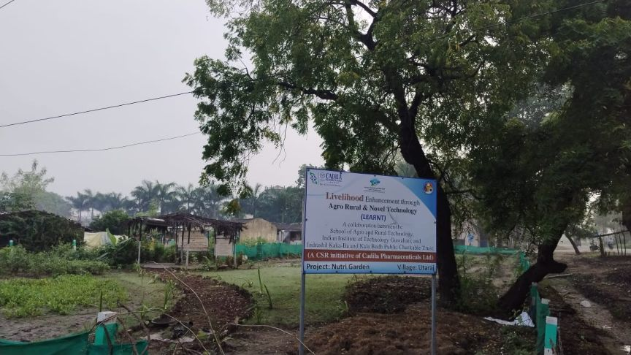
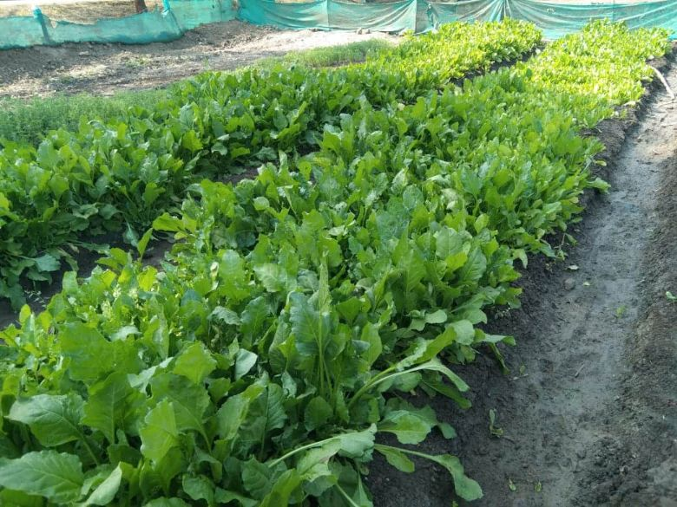
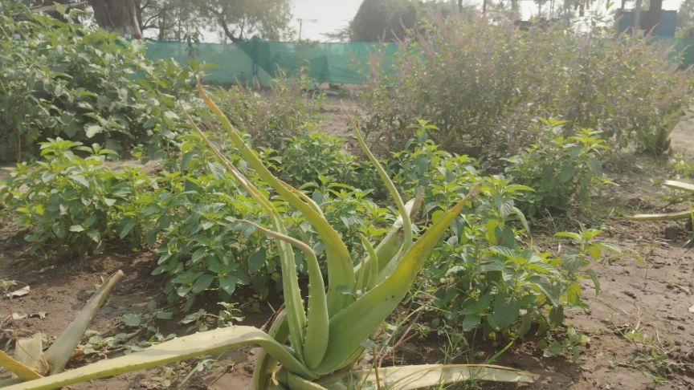
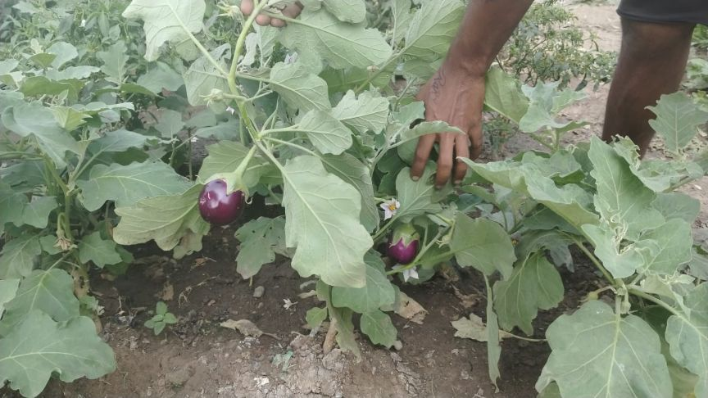
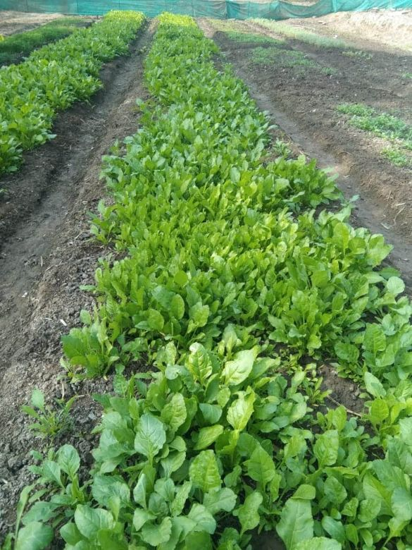
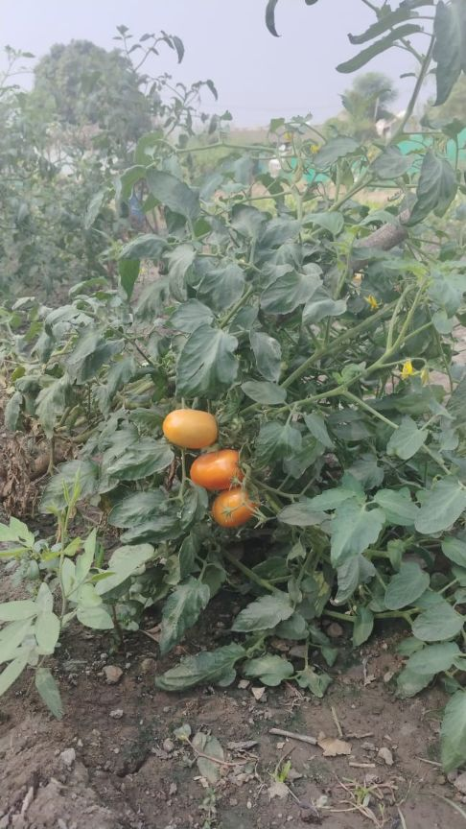
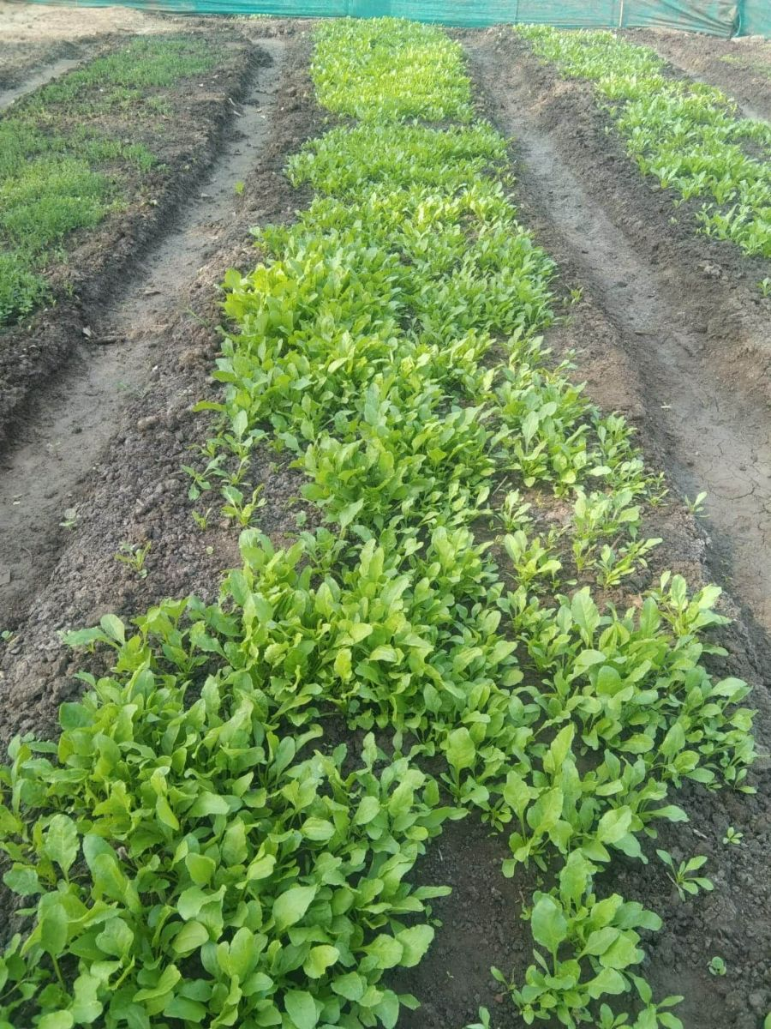
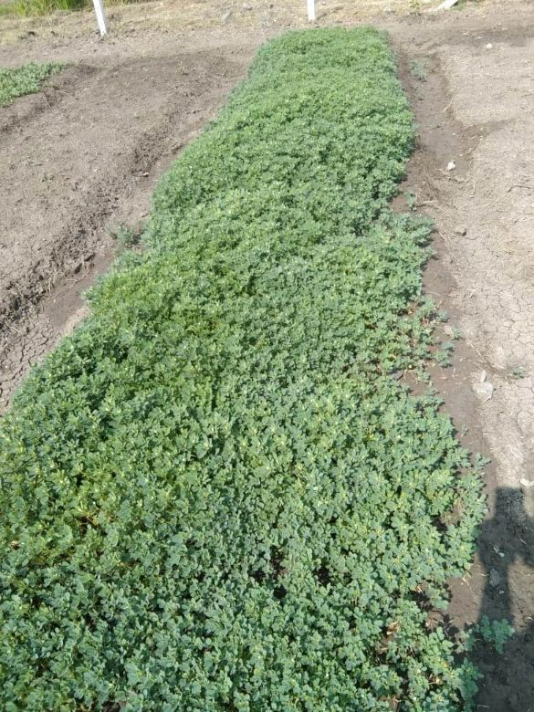
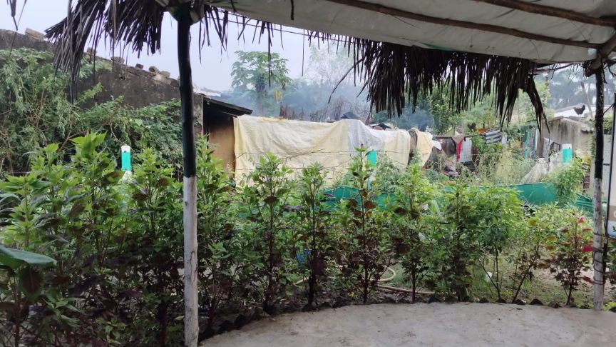
ACTUAL PHOTOGRAPH OF NUTRIGARDEN -VILLAGE UTARAJ
HANSOT TALUKA ,GUJARAT

Slide 11
Nutri diet thru Nutrigarden
BUDGET REQUIREMENT:
Location | Current Status | Future Action Plan | Quater Plan 2025-26 |  |  |  | Investment (Tentative ) | Benefeciaries
 |  |  | Q1 | Q2 | Q3 | Q4
 |  |  |  |  |  |  | 30 lac ( 6lac per village ) | Anganwadi children
 |  |  | Village :Alva | Village:Mangrol | Village:Asta + village in ahmedabad dholka taluka | village in dholka taluka | For 5 no village | School children
Village : Utaraj &Kalam | Both the village Nutrigarden | Further village to be adopted and more |  |  |  |  |  | Adolescent child
Taluka : Hansot (Gujarat) | Implemented and livlihood created | Livlihood to be created | Area : 2000sqft | Area : 2000sqft | Area : 2000sqft | Area : 2000sqft |  | also to make it sustainable model
 |  | For 2025 -26 , 4 more villages to be adopted |  |  |  |  |  | and supply chain to be fixed
 |  | Target output 30 -50k earning per month

Slide 12
MODEL VILLAGE PROJECT
PROPOSAL
FOR
MICROGREEN : A SUPER FOOD

Slide 13
CSR PROJEC B :
Microgreen: A super food
The objective of Microgreen
Microgreens are an emerging horticultural crop with promise for sustainably diversifying food systems and promoting human, population, environmental, and economic health. They are the edible cotyledons (seed leaves) of many vegetables, herbs, and flowers, and are known to have colorful stems and leaves, a variety of textures and flavors, and acceptability by consumers. Available research indicates the micronutrient and phytochemical contents of microgreens are higher than mature plant counterparts, and that they can be sustainably produced with minimal environmental impacts. They can be grown year-round in most indoor locales thus facilitating adaptations to climate change and population growth, while also addressing seasonal crop availability. Their high nutritional quality and potential ease of meal incorporation suggests they can promote vegetable consumption, micronutrient sufficiency, and increased phytochemical intake for the promotion of health, and to achieve specific health effects as functional foods.To date, no research has explored feasibility of daily microgreen consumption in humans, or their potential impacts on health in humans. The overall objective of the project is to determine the feasibility and tolerability of daily microgreen consumption, and to begin to characterize bioavailability and bioactivity of several metabolites associated with microgreen consumption that could positively influence human health and create livlihood.
PROJECT OBJECTIVE :
Microgreens are young vegetable greens consisting of roots, stems, and cotyledon leaves. The stem and leaves of microgreens are concentrated in nutrients making them a potent superfood.
Microgreens are the first true leaves produced from a seedling of vegetables and herbs that are about 2-3 inch tall. There are so many varieties of plants including turnips, radishes, broccoli, cauliflower, carrots, celery, chard, lettuce, spinach, arugula, amaranth, cabbage, beets, parsley and basil, to name a few, that can be grown as a microgreen for a wholesome and nutritious addition to your daily meals.
ORIGIN OF MICROGREEN FARMING :
It has been found that the Microgreen farming was rooted back in 1980s when it first seemed on the menu of chefs in San Francisco, California (United States Department of Agriculture, 2014). Further popularity began in the southern part of California in the 1990s, such that now microgreens are regarded as “functional foods” or “Superfoods.”

Slide 14
BENEFITS OF MICROGREEN
Higher Vitamins and Minerals
Microgreens are packed with essential vitamins and minerals. Studies show they often contain higher levels of nutrients like Vitamin C, E, and K compared to their mature counterparts. This makes them an easy way to boost your diet with essential vitamins.
For example, red cabbage microgreens have been found to contain 40 times more Vitamin E than mature cabbage. This means that even a small serving can offer a significant nutritional boost, ideal for those looking to enhance their meals.
Antioxidant Power
Microgreens are rich in antioxidants, which help combat oxidative stress in the body. Antioxidants are known for their role in reducing the risk of chronic diseases like heart disease and cancer. Including microgreens in your diet can provide an easy source of these compounds.
Microgreens Improves Digestive Health
Though small, microgreens contain fiber that can support digestive health. Fiber aids in regular bowel movements and supports gut health.
Fiber supports the growth of beneficial gut bacteria, which is essential for digestive balance. For those who struggle with digestive issues, adding microgreens can be a gentle way to improve gut health. Their mild flavor makes them easy to include in everyday meals.
Supports Eye Health
Microgreens like pea shoots and kale contain high levels of lutein and zeaxanthin, compounds known for supporting eye health. These antioxidants protect the eyes from harmful blue light and age-related damage.
Including microgreens in our diet can be a practical way to support long-term eye health, particularly in today’s digital age where screen time is high. This makes a valuable addition for anyone concerned about maintaining vision over time.
High Protein Content for Vegetarians
Microgreens like lentils and chickpeas are rich in plant-based protein. This makes them a great choice for vegetarians and vegans looking to supplement their protein intake without relying on animal products.
Protein is essential for muscle repair, immune function, and overall growth. Adding microgreens to meals can offer a protein boost that fits easily into a plant-based diet.

Slide 15
METHODOLOGY
Techniques of Microgreen Farming:
The simple and proper techniques used for Microgreen Farming are :
• Prepare the Container / Tray : Filled the shallow trays with soil, with a depth of about 3-4 inches, as microgreens have shallow root systems.
• Seed Sowing: Evenly spreaded microgreen seeds on the soil surface. There’s no need for precise spacing; hand sprinkling works is done .
• Cover and Pat Down: Gently covered the seeds with a thin layer of soil (1 inches ) and pat it down to help the seeds settle. Moisten the Soil: Spray water over the soil to ensure it’s moist, but avoid overwatering.
• Germination: Placeed the trays on the rack under shed with room temperature for approximately two days to allow germination.
• Regular Watering: Watering the growing greens one / twice a day. In 3-4 days, small leaves developed above the soil with shoots at the base.
• Harvest: When the microgreens reach a height of 2-3 inches, they are harvested. Used scissors/ a sharp knife to cut them, holding them vertically just above the roots.
• Rinse and Use: Wash the harvested microgreens with cold running water and use them immediately in your meal..
Types of Microgreen Farming:
Basically, two types of Microgreen Farming Systems can be created, either it can be Kitchen Microgreen Farming or Indoor Microgreen Farming and Hydroponic Microgreen Farming System.
Methodology:
The seed are chosen for microgreen are in Phase 1
Radish,Moong Beens, Mustard, Brown Lentil, Turnip, Red Amaranth, Black Chickpeas, Green peas, White peas , Coriander, Spinach, Fenugreek, Brocolli, Kholrabi, Celery, Carrot, Kabuli Channa
For Phase 2 : Kitchen garden + Microgreen
Ladies finger, Bringles, carrot, Red Amaranth, Amaranth, Chilli, Red Amaranth, coriander, Kholrabi, Fenugreek, beans, tomato.
Process adopted:
Plastic trays are chosen size 1ftX10” height 2.5” with holes at the bottom
No of tray : 10 nos
Soil preparation with coco pit, cow dung , small quantity of sand (only at the beginning ), and mixing properly to eliminate any lumps.
Filling tray with soil and manure and watering to make soil completely wet.
Apply seed on top and apply a thin layer of soil with manure.
A trial was done by covering the tray for a few days but it is not very unsuccessful.
After a few days observe the growth of microgreens and sprinkle water wherever needed
After growth in 2-3 days, one tray filled with water and a tray with microgreen are placed on top of it for proper water

Slide 16
Health Benefits of Microgreens
FACTS :
Eating vegetables is linked to a lower risk of many diseases as they contain high amounts of vitamins, minerals and beneficial plant compounds which may reduce the risk of the following diseases:
•Heart disease: Microgreens are a rich source of polyphenols, a class of antioxidants linked to a lower risk of heart disease. Studies show that microgreens may lower triglyceride and “bad” LDL cholesterol levels.
•Alzheimer’s disease: Antioxidant-rich foods, including those containing high amounts of polyphenols, may be linked to a lower risk of Alzheimer’s disease.
•Diabetes: Antioxidants may help reduce the type of stress that can prevent sugar from properly entering cells. In lab studies, fenugreek microgreens appeared to enhance cellular sugar uptake by 25–44%.
•Certain cancers: Antioxidant-rich fruits and vegetables, especially those rich in polyphenols, may lower the risk of various types of cancer. Polyphenol-rich microgreens may be expected to have similar effects
•Chronic Disease: Inflammation is a major indicator of disease in the body. Microgreens and vegetable intake in general is shown to reduce inflammation markers as well as lower the risk of several types of cancer.
Most Popular Variety of Microgreens:
Cauliflower, broccoli, cabbage, radish, carrot, garlic onion, Amaranths, beetroot, spinach, melon cucumber and squash.
Cereals such as rice, oats, wheat, corn and barely, as well as legumes like chickpeas, beans and lentils.
They are varied in taste, which can range from neutral to spicy slightly sour or even bitter, depending on variety.
Rainbow of Microgreens:
Fruits and vegetables are available in different colors. Microgreens of different colors represent different healthy compounds called phytochemicals, as well as other micronutrients.
Red vegetables contain lycopene, which is a powerful antioxidant.
Orange and yellow vegetables contain carotenoids like beta carotene and lutein, which the body converts into vitamin A.
Blue and purple vegetables contain anthocyanin which can help protect cells from damage.
Green vegetables contain a wide range of different phyto chemicals including saponins, indoles, and carotenoids.
Brown and white vegetables like garlic contain allicin which has antibacterial properties.
Nutritive Values of Microgreens
Many fresh plants products provide vitamins, minerals and fiber. These nutrients can help with:
1.Preventing a range of diseases.
2.Managing weight
3.Boosting both mental and physical health well-being.

Slide 17
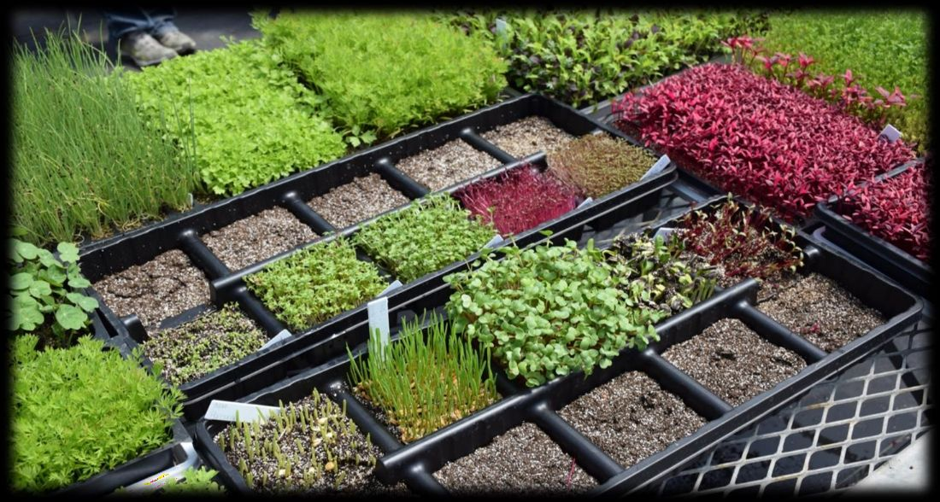
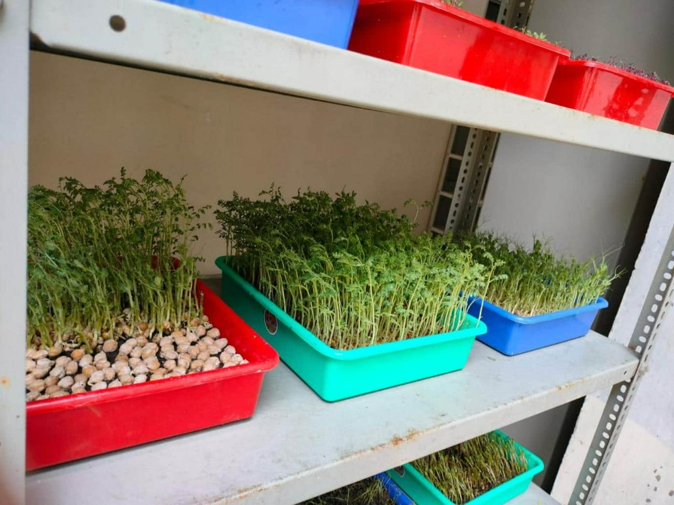
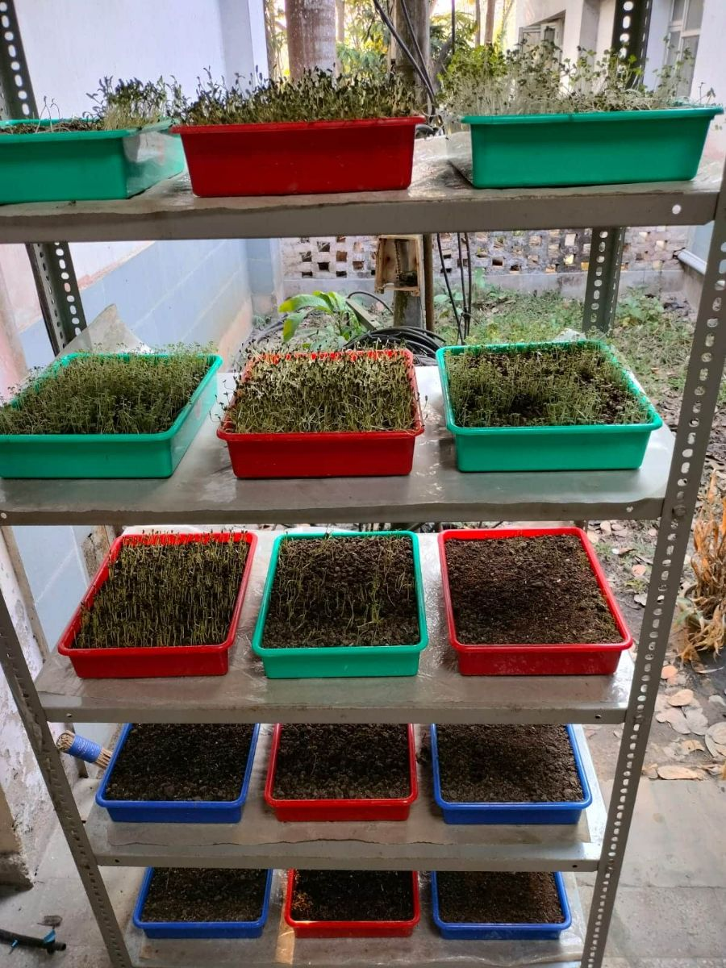
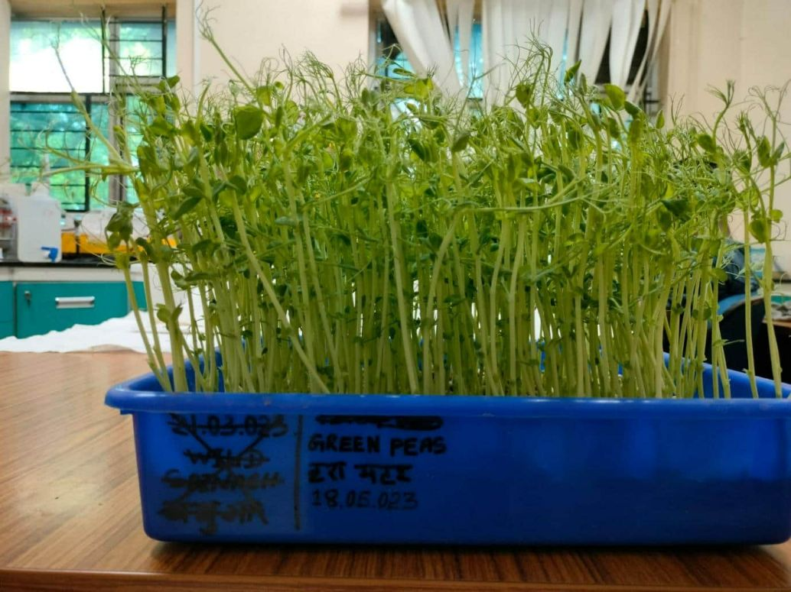
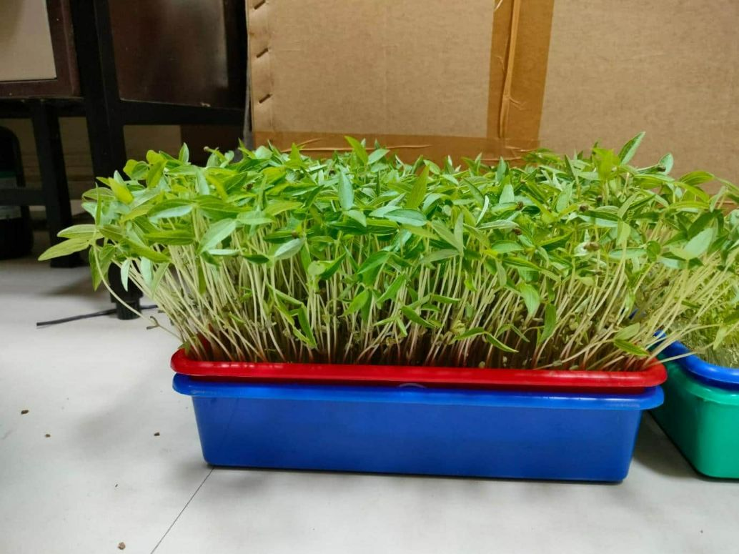
BUDGET REQUIREMENT:MICROGREEN : 2025-26
Location | Current Status | Future Action Plan | Quater Plan 2025-26 |  |  |  | Investment (Tentative ) | Benefeciaries
 |  |  | Q1 | Q2 | Q3 | Q4
Kakaba Hospital Hansot (Gujarat) | 17 tray capacity Microgreen planted | To be replicated to implement in school / Anganwadi or | Kalam | Utaraj | Mangrol + village in dholka taluka | Alva+ Ahmedabad dholka taluka village | 6 lac but depend upon | Anganwadi children
 | as demo plant | in other village location . |  |  |  |  | scale up production | School children & adolescent child
 |  |  |  |  |  |  |  | also to make it sustainable model and supply chain to be fixed

Slide 18
MODEL VILLAGE PROJECT
PROPOSAL
FOR
SOLID WASTE MANAGEMENT

Slide 19
SOLID WASTE MANAGEMENT
FACTS:
Solid waste management remains one of the most daunting environmental sanitation challenges facing the country today and it has continually remained at its lowest ebb despite huge investments in the sector.
Currently, as a result of industrialization and rapid population growth in many cities and towns, wastes are generated faster than they are collected, transported and disposed.
Solid waste management is the collection, transport, processing or disposal, managing and monitoring of solid waste materials.
The term usually relates to materials produced by human activity, and the process is generally undertaken to reduce their effect on health, the environment or aesthetics.
PROJECT OBJECTIVE :
The underlying objectives of any waste management programmes will include:
To protect human health and improve quality of life among people living in the area
To reduce environment pollution and make the area clean
To promote recycling and reuse of both solid waste
To convert bio waste into energy for ensuring greater energy security at the community level to generate employment for the poor by offering new opportunities in waste management by adopting cost effective and environmentally sound solid waste treatment technologies.
Management of solid waste reduces or eliminates adverse impacts on the environment and human health and supports economic development and improved quality of life.
Solid waste management is a distinct practice from resource recovery which focuses on delaying the rate of consumption of natural resources.
The various processes involved in effectively managing waste for a municipality which include monitoring, collection, transport, processing, recycling and disposal shall be treated in detail in our subsequent discussions.

Slide 20
SOLID WASTE MANAGEMENT
Waste Management Process
Ensuring Environmental Health and Resource Recovery. Waste management encompasses the collection, transportation, processing, recycling, or disposal of materials generated through human activity. This process is primarily aimed at mitigating their impact on both human health and the environment. Additionally, waste management strives to extract valuable resources from these materials. It covers a wide range of substances, including solid, liquid, gaseous, and radioactive, each requiring specialized methods and expertise for proper handling.
Studies have shown that waste management practices vary depending on factors like a nation’s level of development, urban or rural settings, and whether the waste is generated by residential or industrial sources. Typically, local government authorities oversee the management of non-hazardous waste from homes and institutions in metropolitan areas, while generators of non-hazardous commercial and industrial waste usually handle its management.
An efficient waste management system plays a crucial role in ensuring the smooth operation of various interconnected systems. These systems are vital for tasks such as waste containment and leachate management. Without regular examination, maintenance, improvement, and assessment of the components of a waste management system, even the most well-designed unit may not function optimally.
Effective implementation of a waste management system can lead to reduced costs in both the short and long term, provide protection for workers and local communities, and foster positive community relations. Furthermore, a successful waste management system necessitates the establishment of procedures for monitoring performance and tracking progress towards clearly defined environmental objectives.
Types of Waste
The rapid pace of economic development has led to an improved standard of living worldwide. This, in turn, has resulted in increased material consumption and subsequently, higher waste generation. Solid waste materials generated, particularly in urban areas, include:
Organic waste
Plastic waste
Metal waste materials
Glass waste materials
Paper waste materials
Electronic waste

Slide 21
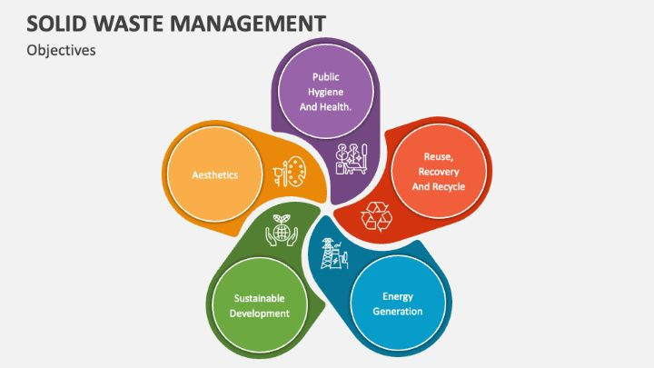
SOLID WASTE MANAGEMENT
Objective of Waste Management
The primary aim of waste management is to reduce waste generation, ultimately striving for an ideal system. Conversely, resource management seeks to maximize the efficient use of available resources. Both waste and resource management share a common objective: the optimal utilization of resources to enhance system efficiency and growth. However, their approaches differ (Arora, 2004).
To accomplish this objective, it is crucial to:
Prevent the generation of waste.
Encourage the reuse of waste.
Support the biological recovery and material recycling of waste.
Promote the energy utilization of waste that isn’t suitable for recycling.
Ensure that the treatment and disposal of waste do not result in any harmful impacts

Slide 22
BACK GROUND OF STUDY
PROJECT AIM :Solid waste management at Utaraj and Alva village.
The broad objectives of the SURVEY Report are to determine a technically and economically viable solid waste management project for the Hansot Taluka and study detail as below.
The ultimate goal to be zero waste in village thru adoption of home composting and recycle of waste.
Following are the specific objectives:
(i) To devise a system for effective and efficient method of (Municipal Solid Waste or domestic Solid waste) MSW disposal.
(ii) To assess Project feasibility
(iii) To assess Environment Impact Assessment of the Project
(iv) Cost Estimate
(v) To prepare operational plan
(vi) Organizational and Financial Studies
(vii) Training and Capacity Building
Scope & Limitations of the study
The study is initially limited to Hansot Taluka under 3 villages. These are
Utaraj
Kalam
Alva
As per the report released by government of India , It is projected that by the year 2031the MSW generation shall increase to 165 million tons and to 436 million tons by 2050.
Increasing population, volume, and complex nature of generated solid waste, improper implementation of existing rules, failure of waste disposal techniques, limitation of funds and infrastructure are the common causes of unsustainable solid waste management in many countries of the world including India. Further, traditional beliefs and approaches such as “out of sight, out of mind,” “not in my backyard (NIMBY)” and “flame, flush or fling” even towards the generated solid waste results in an unsustainable society which hinders sustainability.
A management system from generation up to final disposal of wastes in an environment friendly, economically affordable, and socially acceptable way is termed “Sustainable.” According to the Indian Planning Commission report of 2014, if effectively managed, the unused MSW will generate about 439 MW of power, 1.3 million m3 of biogas/day, or 72 MW of electricity from biogas and 5.4 million metric tonnes of compost annually. Many times improper use and ineffectiveness of different available techniques of harnessing energy and wealth from the wastes cause more environmental costs than economic gains.
“Municipal solid waste is defined to include refuse from households, non-hazardous solid waste from industrial and commercial establishments, refuse from institutions, market waste, yard waste and street sweeping, etc.

Slide 23
BACKGROUND ANALYSIS
Accordingly, waste management should be an integrated affair, which shall include:
1)Minimizing waste,
2)Maximizing environmentally sound waste re - use and recycling
3)Promoting environmentally sound waste disposal and treatment and
4)Extending the coverage of waste management services
The stages involved in SWM are primarily as follows:
1)Primary collection of solid waste from household levels
2)Primary transportation to municipal waste bins and collection points,
3)Secondary transportation of garbage from municipal bins to disposal sites, and Actual disposal of the waste.
There is a stage between the collection and disposal of solid waste, that is, resource recovery or segregation of degradable and recyclable materials in the garbage and actual recycling. In Hansot and nearby village no separation of garbage between degradable and non – degradable items and recycling taken up at the municipal level. This is so not only because it is uneconomical. since only 13 to 20 % of municipal waste is recyclable the remaining 80-85% is compost but in case of Hansot and nearby village 80 – 85% plastic, paper etc for recycle and around 20% is domestic waste for composting. In most cases however, secondary waste collection is not being done adequately. On an average, 20 to 30 per cent of the total waste generated remains uncollected, creating Environmental hazards in urban settlements.
Now a day due to increase in the environmental concern, emphasis is laid on recycling and reuse of domestic garbage is gaining momentum. The municipalities and municipal corporations themselves are unable to take up such projects of collection, segregation, and recycling or composting in an integrated manner because of the high costs involved. Here the opportunity to define a sustainable model for complete Solid waste management and create livelihood thru wealth generation. Many private agencies are now providing these services to the Municipalities or are independently running some projects for waste collection, segregation, recycling and composting or even bio-gas generation.

Slide 24
PRESENT SITUATION / INFRASTRUCTURE FOR SWM
1. Dustbin provided to a individual houses in Utaraj and Kalama. 2. Tractor provided in Utaraj only for collection from door to door
3. No segregation is going on . 4. Garbage scattered many places even disposal place is available
5. 80% Plastic and 20% non-plastic waste. 6. No compositing or recycling of garbage
7. Local gram panchayat involvement to be enhanced . 8. No municipal or Government collection and disposal of garbage exist in Taluka or villages.
9. All garbage scattered in multiple location creating health hazard and polluting the environment. 10. Some domestic waste is being fed to domestic animal.
11. Once more garbage is piled up than it is burnt in villages.

Slide 25
SCOPE AHEAD
The budget for SWM Project in Utaraj and Alva are as below :
1. Electric vehicle 2 nos for garbage transportation - Rs 9 lac one time investment
2. Manpower ie labour for collection and disposal of garbage (10 person).Rs 1.05 lac per month
3. Vehicle driver cost ( 2 driver ) .Rs 20,000/- per month
4. Supervisor (2 person ).Rs 30,000/- per month
5. Distribution of dustbin to all household .Rs 1.5 lac one time investment
6. Banners and poster cost for SWM.-Rs 50,000/- one time investment
7. Training and miscellaneous cost.Rs 50,000/- per annum
INITIAL TOTAL FUND REQUIREMENT - Rs 13,000,00/- + recurring monthly cost for one village .
FOR 3 VILLAGE TOTAL BUDGET REQUIREMENT : 25 LAC (TENTATIVE)
1.Ample opportunities in villages to make villages clean, sarpanch participation and team formation
2.Under SBM, villages will have composting and SWM disposal shed, provide by Government.
3.Third party collection and reuse the plastic from nearby location
4.Start with One village UTRAJ and make it a best model village to replicate further.
5 Involvement of Panchayat Development Officer and SBM officer showing positive participation to make SWM a successful project.
6 Aim towards “ZERO WASTE VILLAGE “

Slide 26
THANKS

Slide 27
MODEL VILLAGE PROJECT
PROPOSAL
FOR
Water Conservation through Rejuvenation of Pond with Participatory Community Engagement

Slide 28
Many cities of India are predicted to start going dry within just 10 years. One way to postpone this predicament is to have ponds that would not only harvest the rainwater but would recharge the ground water too. Increase in biodiversity is an added advantage. India had many ponds historically, but many are lost now because of landfill or neglect.
Water is a prerequisite for all the development activities and its conservation and efficient management needs to take center stage for sustainable development. India faces major challenges with declining per capita water availability and stands stressed with rising water demand mainly from the already competing agriculture, domestic and industrial sectors.

Slide 29
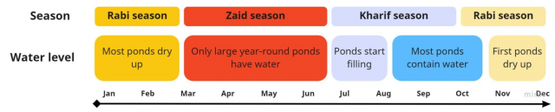
In order to respond to these growing challenges, it is imperative that water conservation interventions should be mandated as an integral part of water use and management in Rural India.
Being part of Model village water preservation,use and maintain is considered to be one of the most important project to be considered

Slide 30
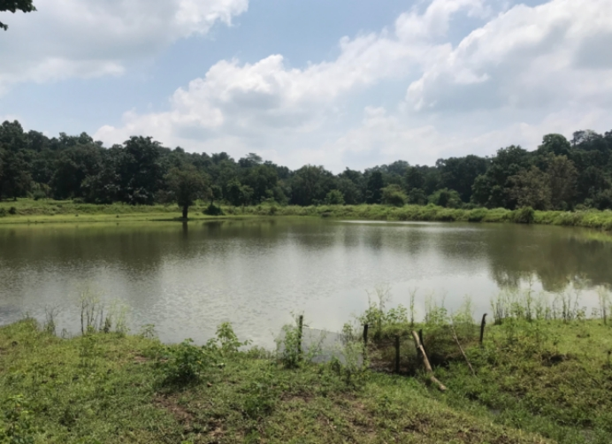
Farm ponds serve as water harvesting structures that capture surface rainwater runoff to support protective irrigation during lean periods. These ponds have a proper inlet for collecting the surface runoff from its catchment and may have an outlet for delivering water downstream. Ponds thus play a significant role in the landscape and crop growth through irrigation water supply and local climate effects.
Pond in Gubari, Madhya Pradesh, India. This pond is used to produce fish for 65 households
How ponds can create conducive local climates

Slide 31
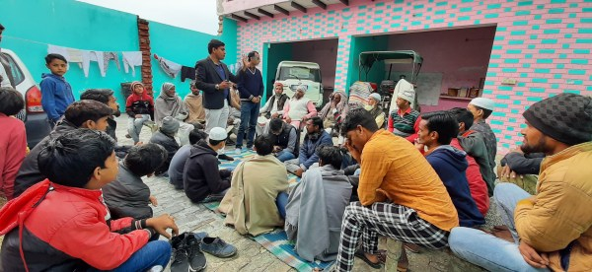
PATH TO PROJECT IMPLEMENTATION
pond restoration techniques and engages with local communities to raise awareness about the importance of these water bodies. On how they find these ponds, Tanwar explains, “We run social media campaigns where people share pictures of water bodies in their areas. Sometimes, district administrations of different states and Gram Pradhans of different villages contact us.” The NGO operates with funds donated by individuals and CSR funds released by different companies.

Slide 32
The first and foremost step is to engage the local community. Involving the people living around the ponds is crucial for long-term success. “This is why much of the pond rejuvenation is done by hiring a team from the same community, which not only gives them a source of income but encourages community participation,”
The process differs for each pond, and the timelines hover around six months on average. “ clear out the water body and dig a pit with wooden mesh to collect garbage. Extracts different garbage eg plastic each lake. While the plastic would be sent for recycling, they then install a double filtration system with a filter made of wooden planks and a patch of different grasses to prevent bigger and smaller pieces of garbage from making their way into the water in the future. Volunteers clean these pits once a week,” he explains. To enhance the pond’s ecological value, need to promote planting native aquatic plants along the pond’s periphery. These plants help filter the water, provide habitat for wildlife, and stabilise the ponds’ banks. Restoring water bodies and wetlands will eventually help cities deal with the concern of dwindling ground water levels. “These restored bodies will help recharge the water table in the region, and help us, in some way, deal with the water scarcity in the future,

Slide 33
A restored, and well-managed pond/tanks directly or indirectly contribute to the three circular economy principles, (a) Regenerating natural capital (i.e., biodiversity, water cycle, nutrient cycle, and water quality); (b) Keep resources in use (i.e., enhance resource use efficiency of material and energy); and (c) Design out waste externalities (i.e., reduce environmental impacts, waste reduction, and economic sustainability)

Slide 34
Factors that helped in the rejuvenation process:
Universal education: The village had only primary school. But now with the help of the alumni of that school, a high school has also started in the village. Students from all the households come to the school – there is no caste bias. The presence of the school and its devoted principal, Mr Zala, has made almost the whole village educated. Students of this school have succeeded in getting jobs in MNCs and even abroad. The money from such people is flowing in to make the village more beautiful.
Trust in the community leaders: The community leaders like Mr Prakash, Milan and Chirag Rawal, Mr. Dharmendra Singh, Jatubha and Mr Zala have used the money donated by the expatriates to make good changes for the village. Such developments have been noticed by the villagers hence they know that the work proposed by these leaders will be for the good of the village. In this way, it has been easy to get the cooperation of the whole village for any developmental work.
Money donated by the expatriates: The people who have left the village for better lives have not forgotten their ties with this village. They have been generously donating money for the upliftment of the village. This has helped considerably in building the village infrastructure
PROJECT COST VARIES FROM 15LAC TO 20 LAC PER POND DEPEND UPON THE LOCATION SIZE AND DEMOGRAPHY

Slide 35
THANKS

Slide 36
MODEL VILLAGE PROJECT
PROPOSAL
FOR
Rain Water Harvesting in Rural Areas

Slide 37
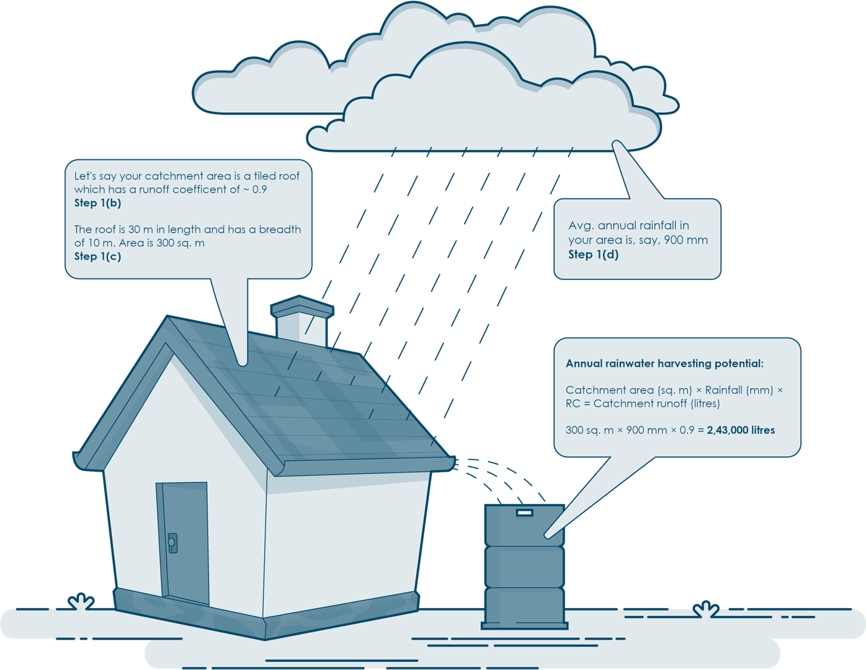
Secure the future drop by drop, embrace rainwater harvesting.

Slide 38







Household
level
Institutional Buildings
Aanganwadi
/ Schools
Hospital Buildings
Farms

Slide 39






















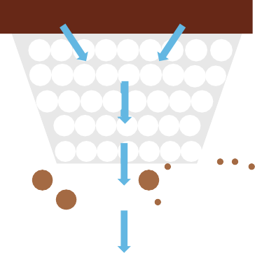
DRINK RAINWATER
COLLECT RAIN WATER
RECHARGE RAIN WATER
STORE RAIN WATER

Slide 41
1.Catchment area
The surface that receives rainfall directly is the catchment of rainwater harvesting system. It may be terrace/roof and open ground/farmlands.
Rainwater harvesting can be done on any type of rooftop -
corrugated sheets, GI sheets, tiled or RCC roof.
Cleaning of the roof before and during monsoon is
mandatory; avoid storing materials on it.
Roof surfaces should be smooth, easy to clean & durable
to prevent material shedding into the water
Rainwater harvesting can also be done on open grounds in villages or farmlands.

Slide 42
2.Conveyance system
To efficiently capture and transport rainwater, a well-designed conveyance system is essential. Channels along the edge of a sloping roof collect and direct rainwater to the storage tank. Gutters can be semi-circular or rectangular.
Gutter Installation for Rainwater Collection:
Gutter should be placed on the edge of the roof on both sides from where monsoon water will fall.
Use locally available materials like bamboo, PVC pipes, or metal sheet.
Use semi-circular or rectangular gutters for optimal flow.
Install with slight slope (1:100) toward collection point and ensure joints are
properly sealed.

Slide 43
3.Rainwater filters/ First flush
•First flush is a device used to flush off the water received in first rains.
•A first flush system diverts initial dirty runoff, and a filter unit removes debris and contaminants before water enters the storage tank. It will also help in cleaning of silt and other material deposited on roof during dry seasons.
Install the first flush device before the main storage tank and it should be easily accessible for regular maintenance.
Install a basic PVC pipe diverter with a removable end cap to divert the first 3–4 rains before directing water or use rainwater filter to remove initial rainwater before storage.
Remove and clean rainwater filters before and after each rains to remove dirt, leaves and other debries. This will prevent clogging and ensure proper operations.

Slide 44
4.Storage tank
•The rainwater storage tank collects all the filtered rainwater and keeps it for future use.
•The storage tank is made above the ground or underground.
Annual drinking and cooking water requirement for a family of five:
3 Liters Per person/day
5000 liters requirement/year
5 Family members
Drinking Water
( 5 Member * 3 Liters per person * 365 days )
8 Liters Per person/day
15000 liters Requirement/year
Drinking + Cooking Water
( 5 Member * 8 Liters per person * 365 days )

Slide 45
Let's calculate rainwater harvesting potential for our villages !
Total rainwater harvesting
potential per households
Total rainwater harvesting potential for entire XY village
= 2500 * 80 * 0.8
= 1,60,000 liters/year
= 1,60,000 * 300
= 48,000,000 liters /year
Let's assume,
Annual water requirement = 70 lpcd* 5 persons *365 days for one household = 1,28,000 liters/year

Slide 46
PROJECT COST
When community come together to harvest rain, the per-capita investment goes down. For instance, Panchsheel Park Colony about 1000 residents pooled in
Rs 4.5 lakh to harvest more than 170 million litres of water annually.
Rainwater harvesting methods are site specific and hence it is difficult to give a generalised cost. But first of all, the major components of a rainwater harvesting system - rain and catchment area - are available free of cost. A good proportion of the expenses would be for the pipe connections. By judiciously fixing up the slopes of roofs and location of rainwater outlets, this could be brought down considerably. However the cost varies widely depending on the availability of existing structures like wells and tanks which can be modified and used for water harvesting.
Typically, installing a water harvesting system in a building would cost between Rs 2,000 to 30,000 for buildings of about 300 sq. m. The cost estimate mentioned above is for an existing building. For instance, water harvesting system in the CSE building in Tughlakabad Institutional Area, Delhi, was set up with an investment of Rs 30,000 whereas those in the model projects ranged between Rs 70, 000 and Rs 8 lakh. The costs would be comparatively less if the system were incorporated during the construction of the building itself.

Slide 47
MODEL VILLAGE PROJECT
PROPOSAL
FOR
Rural Forestation

Slide 48
The Government of Gujarat is running a programme to restore degraded forests and improve the livelihoods of people living in and around forest areas. The project is intended to raise the level of understanding of the dynamics involved in developing forest ecosystems, and to improve the knowledge base for sustainable forest management. The tribal areas along the eastern border of the state of Gujarat are particularly affected by forest decline. Here the Gujarati Government has commissioned GIZ IS to manage a pilot project to improve the use of forest resources and enhance the tribes’ livelihood opportunities.
Objective
The quality and extent of forest cover have improved as a result of better forest management, rehabilitation and protection practices, and due to the improvement of local livelihoods. Sustainable forest management models are being disseminated more widely.
Approach
The project aims to encourage the participation of village communities in Joint Forest Management Committees (JFMC) and, with them, to pursue the regeneration, conservation, development and maintenance of degraded forests. At the same time it is working to secure incomes for the villagers, and to meet their requirements for grass, firewood and other resources, while also promoting sustainable forestry. The project also aims to provide models of sustainable forest management practices and institutional arrangements for wider replication, and to support the economic transition of forest-dependent communities.

Slide 49
Results achieved so far
An operational plan has been developed for the delivery of consultancy services.
About 3,000 women’s self-help groups have been established, which now have access to banks and saving facilities.
Measures such as methodology training have been provided in support of socio-economic research.
Six eco-tourism sites have been created and transferred to eco-development committees near the protected forest areas.
Thousands of micro-plans have been prepared and are in the process of implementation.
The population densities of key wild animal species have been maintained, as have as the density and richness of botanical species.
Training and capacity building activities are now available for local non-governmental organisations.
A manual on micro-enterprise development has been compiled to serve as a basis for improving local incomes.

Slide 50

Miyawaki Forest in Gujarat
The Miyawaki method, named after Japanese botanist Akira Miyawaki, involves planting native species close together. This technique accelerates growth, creating a self-sustaining forest in just a few years. It's a game-changer for regions like Gujarat, where rapid urbanization has led to deforestation.
The Japanese Miyawaki technique takes a lot of effort, such as ploughing the soil, using fertiliser, compost and coco peat, etc. All these make this process extremely fancy and cost up to ₹ 300 to ₹ 350 per sq. ft. of a planting area.

Slide 51
The Multiple Benefits of the Miyawaki Method
In the 1970s, the Japanese ecologist Akira Miyawaki developed a novel method of forest regeneration aimed primarily at restoring degraded sites and promoting resilience. The method has been adopted across much of the world, mostly to restore tropical forest and also to increase forest cover in urban areas.
It has recently become more popular in Europe, the UK and even India.
Recently, Pehel Foundation, the CSR wing of PNB Housing began working along with BharatCares to re-green the city. The duo involved SayTrees, a social enterprise focussed on increasing the tree cover across India through the Miyawaki method.
In a small plot of land at Anekal, Bengaluru, the team is growing 6300 saplings. They are native varieties like papaya, guava, seethaphal, jasmine, badam and more. What started as small saplings not more than 2 feet tall, today, the saplings are adult trees that are 6-7 feet tall.
In the same manner, the project is also being carried out in Narela, New Delhi. Here 2000 saplings of apple, champa, amla, jungle jalebi, orange, lime, hibiscus, tamarind among others are growing.

Slide 52

The forest provides cleaner air and job opportunities. Even on a sunny day, the houses surrounding the Miyawaki forest are prone to receive more shade and cooler air. For maintaining the plantation site, workers are currently being appointed from the surrounding villages.
The benefits of a Miyawaki forest
Miyawaki forests grow rapidly, increase soil- and forest-biodiversity, increase carbon sequestration, increase forest resilience and reduce maintenance costs.
Ecological benefits
Miyawaki forests have been shown to be more resilient than traditionally planted forests. Research has found that these forests have a much greater biodiversity – above ground and below. Deadwood and leaves are left alone. This provides potential habitat for fungi and invertebrates.
The diversity of plants is attractive to various types of fauna, providing habitat and food for everything from invertebrates to birds to mammals. Miyawaki forests achieve ecological succession within 20 or 30 years, compared to 100-200 years for a traditionally planted forest.

Slide 53
Cost effective
Miyawaki forests often require less initial cost of funds, which may include installing a watering system, labor costs for planting and the first few years of development, the price of saplings, and the price of soil additives.
In the long run after the initial period of growth, investment requirements are little to none. Additionally, the growers can increase the economic value of their forests by incorporating high-value native timber trees and creating “Miyawaki Fruit Forests”, by providing forest tours, nature walks and educational sessions.
Carbon sequestration
Miyawaki technique trees are planted, and they develop much more quickly, accelerating the process of creating forests and absorbing more carbon. The best part of the technique is that after three years saplings become maintenance-free or self-sustainable.
Being capable of rapidly establishing diverse, healthy forests could be crucial in fulfilling international targets and addressing these concerns in light of the current climate change emergency and alarming warnings about worldwide biodiversity loss.
PROJECT COST (MIYAWAKI )
900 SQ METER OR 10,000 SQ FEET COST VARIES FROM 7 LAC TO 10 LAC

Slide 54
THANKS

Slide 55
MODEL VILLAGE PROJECT
PROPOSAL
FOR
Poly House Farming

Slide 56
Polyhouse farming is a modern agricultural practice that involves cultivating plants within a controlled environment using transparent or semi transparent materials.
These environments are typically made up of plastic or metal frames with transparent walls and roofs. It’s beneficial as compared to open field crops because the returns are good as poly house allows to grow crops throughout the year irrespective of the season. Also, the quality of produce is better than the open field cultivation. The yield under polyhouse or greenhouse cultivation can be achieved to the level of 4 to 8 times as compared to open field crop cultivation.
Different Types of Polyhouse
Polyhouses can be classified based on two parameters: the environmental control system and the construction type.
Based on the Environmental Control System:
1- Naturally Ventilated Polyhouse
This type of polyhouse is the most basic form and relies on natural air circulation. It is designed with vents at the top and sides that allow for the exchange of air. The vents can be opened or closed to control the temperature and humidity inside the polyhouse. However, the control over the internal climate conditions is limited in this type of polyhouse. It is suitable for regions with moderate climates where the external weather conditions are not too extreme.

Slide 57
2- Environmentally Controlled Polyhouse
This type of polyhouse is more advanced and allows for precise control over the internal environment. These polyhouses often include automated systems for irrigation, fertilization, and pest management. However, these polyhouses are more expensive to construct and maintain, and they require a reliable source of electricity to run the control systems.

Slide 58
Based on the Construction Type:
1- High-Tech Polyhouse
These polyhouses are built with rigid materials like glass or polycarbonate. The glass or polycarbonate panels need to be cleaned regularly to ensure maximum light transmission, and they may need to be replaced if they get damaged.
2-Moderate Tech Polyhouse
These polyhouses are constructed with flexible materials like polyethylene or PVC. They are less expensive and easier to construct than rigid polyhouses, but they may not last as long.
3- Low-Tech Cheap Polyhouse
This type of polyhouse is simple and cost-effective. They do not provide the same level of control over the internal environment as the other types of polyhouses.
The choice of polyhouse depends on the farmer’s specific needs, including the type of crops to be grown, the local climate, and the available budget.

Slide 59
Advantages of Polyhouse Farming
Here are some of the key Advantages of polyhouse farming:
Controlled Environment: In a polyhouse, plants are grown under controlled temperature conditions, reducing the chances of crop loss or damage.
Year-Round Cultivation: One of the major advantages of polyhouse farming is the ability to grow crops throughout the year, without having to wait for any particular season.
Pest and Disease Control: Polyhouses provide a protected environment for crops, reducing exposure to pests and diseases.
Quality of Produce: The controlled conditions inside a polyhouse can lead to the production of higher-quality crops. The produce grown in polyhouses is often superior in terms of size, color, and nutritional value compared to those grown in open fields.
Water Conservation: Polyhouse farming often incorporates drip irrigation systems, which can significantly reduce water usage compared to traditional farming methods.
Increased Yield: Polyhouse farming can increase yield by about 5 to 10 times compared to traditional farming methods. This is due to the optimal growing conditions and the ability to grow crops throughout the year.
Less Cropping Period: The controlled environment in a polyhouse can accelerate the growth of crops, leading to a shorter cropping period.
Easy Fertilizer Application: Fertilizer application is easier and can be controlled automatically with the help of drip irrigation in a polyhouse.
Disadvantages of Polyhouse Farming

Slide 60
POLY HOUSE FARMING COST
Polyhouse farming is a modern agricultural practice involving cultivating plants in a controlled environment. Here’s a breakdown of the Polyhouse farming cost in India:
1. Polyhouse Construction Cost: The cost of constructing a polyhouse can vary greatly depending on the type and size of the polyhouse. Here are some estimates:
The lowest cost is around Rs. 600 per square meter for a tunnel form polyhouse.
A naturally ventilated polyhouse without automation ranges from Rs. 800 to Rs. 900 per square meter.
The cost can go up to Rs. 4000 per square meter for more advanced polyhouses.
For a 1-acre land polyhouse with a measurement of 100×40 square meters, the total cost could be around 600,000 INR.

Slide 61
PolyhoPOLY HOUSE FARMING SUBSIDY
The Government of India offers subsidies for polyhouse farming through the horticulture department. These subsidies can significantly reduce the initial investment required for a polyhouse.
Farmers must meet certain eligibility criteria to qualify for the subsidy. These criteria may include having a minimum landholding size and using approved materials for the polyhouse.
The Government of India offers a variety of subsidies to farmers who establish polyhouses. The subsidy amount can reach up to 80% of the project cost. However, it’s important to note that the exact amount can vary from one state to another.
The National Horticulture Board (NHB) is the regulatory body in India for greenhouse farming. The NHB provides a subsidy of 50% on a project of 112 lakh maximum ceiling per beneficiary.
The Sub-Mission on Agricultural Mechanization (SMAM) is another initiative that provides financial assistance to polyhouses. The subsidy amount under SMAM 50% of cost (15% higher for hilly areas), Rs. 700/- to 825/- per sqm. for Protected Cultivation Green House, Fan & Pad System (limited to 4000 sq m per beneiciary)
Eligibility for Availing Subsidy: Polyhouses having an area above 2500 sqm are eligible for subsidy. In the case of the Northeast region, the minimum area is over 1000 sqm.

Slide 62
THANKS

Slide 63
MODEL VILLAGE PROJECT
PROPOSAL
FOR
Honey Bee Farming

Slide 64
Honey bee farming, commonly known as beekeeping, is the care and breeding of honey bee colonies for producing honey and other bee-related goods such as propolis, beeswax, and royal jelly. In India, honey bee farming has a long history and is essential to the country’s agriculture sector. India is known for its diverse range of honeybee species, and honey production in India mainly uses Apis cerana and Apis mellifera species.
India is the second-largest honey producer in the world after China and has many beekeepers, most of whom are small-scale farmers. The country has a wide range of climatic and geographical conditions, which support the growth of different ora and fauna, thus providing a suitable environment for honeybee colonies. The honey produced in India is known for its high quality and unique taste, and it’s in high demand both
locally and internationally.

Slide 65
Modern bee farming
Modern bee farming is a technique that has been developing for a long time and is popularly run by most new bee farmers. In this technique, bees are raised in modern arti cial wood containers and are called modern beekeepers. Raising bees in a wooden
box is bene cial as it does not harm the honey bee eggs, and honey can be quickly taken out from the box by the beekeeper. Proper care and a good relationship between the beekeeper and the bees are the main factors that affect honey production.
One can easily earn a high amount of pro t with low investment. Top bar hive method This method of bee farming is highly adopted by people because of its advantages. The top bar hive is light in weight, easy to harvest honey, and bees experience low stress while creating honey. This method has been used as a traditional method by countries like Greece and Vietnam for a long time. It is common in Africa for honey collection. However,
the comb cannot be reused after one-time honey extraction, which results in less honey production and affects the pro t.
Modern bee farming
Modern bee farming is a technique that has been developing for a long time and is popularly run by most new bee farmers. In this technique, bees are raised in modern arti cial wood containers and are called modern beekeepers. Raising bees in a wooden box is bene cial as it does not harm the honey bee eggs, and honey can be quickly taken out from the box by the beekeeper. Proper care and a good relationship between the beekeeper and the bees are the main factors that affect honey production.
One can easily earn a high amount of profit with low investment. Top bar hive method This method of bee farming is highly adopted by people because of its advantages. The top bar hive is light in weight, easy to harvest honey, and bees experience low stress while creating honey. This method has been used as a traditional method by countries like Greece and Vietnam for a long time. It is common in Africa for honey collection. However,
the comb cannot be reused after one-time honey extraction, which results in less honey production and affects the profit.

Slide 66
Importance and bene ts of Honey Bee farming
Beekeeping provides important products such as honey and beeswax. Also, it plays a vital role in pollination, which increases crop yields. Additionally, recent studies have shown that bee venom has potential uses in the medical industry, speci cally in the ght against HIV/AIDS. Overall, beekeeping is essential in the food and agricultural industries and the medical and cosmetic industries.
. Economic bene ts: Honey bee farming provides a source of income by selling honey, beeswax, and other bee-related products.
. Pollination: Honey bees are essential pollinators for many crops, including fruits, vegetables, and nuts. It can increase crop yields and improve food security.
. Environmental bene ts: Honeybees are crucial in maintaining biodiversity and preserving natural habitats. They also help to pollinate wild plants, which provide food for other wildlife.
. Health bene ts: Honey is a natural and nutritious sweetener and has been shown to have antimicrobial and anti-in ammatory properties. Bee venom has also been found to have medicinal properties.
5. Educational and research opportunities: Beekeeping can be a valuable educational tool for children and adults, providing opportunities for research on bees and the environment.
6. A way to protect bees: Honey bee farming is a way to protect and preserve the honey bee population, which has been declining in recent years due to factors such as habitat loss and pesticide use.

Slide 67
Business plan
. Research and Planning: Before starting the business, it is important to conduct thorough research on the bee species available in the region, the market demand for honey, and the costs involved in setting up and maintaining a bee farm.
. Location: A suitable location for the bee farm should be selected, considering factors such as the availability of oral diversity, water sources, and the proximity to the market.
. Bee Colonies: Purchase or rent bee colonies from local beekeepers or breed them in- house.
. Equipment: Acquire essential equipment such as hives, honey extractors, bee venom collectors, smokers, and other tools required for beekeeping.
5. Maintenance and Care: Proper care and maintenance of bee colonies are essential for producing high-quality honey. It includes regular inspections of the hives, providing adequate food and water, and controlling pests and diseases.
6. Marketing and Sales: Identify potential buyers and markets for the honey produced. It can include local markets, supermarkets, and online platforms.

Slide 68
Project cost
. Bee colonies: The cost of purchasing bee colonies can vary depending on the type of bees and the number of colonies needed. On average, a bee colony can cost between Rs. 5,000 and Rs. 20,000.
. Beekeeping equipment: Equipment such as bee hives, protective gear, honey extractors, and other tools will be needed for the beekeeping process. The cost of these items can vary depending on the quality and brand, but on average, the equipment
can cost around Rs. 50,000 to Rs. 1,00,000.
. Land and infrastructure: The cost of land and infrastructure will depend on the location of the farm and the size of the land required. The land cost can range from Rs.
1,00,000 to Rs. 5,00,000.
. Labor costs: The labor cost will depend on the number of workers required to manage the bee farm and the hourly wages paid to them. On average, labor costs can range from Rs. 20,000 to Rs. 1,00,000.
5. Marketing and advertising costs: The cost of marketing and advertising will depend on the marketing strategy used and the budget allocated for it. On average, marketing and advertising costs can range from Rs. 10,000 to Rs. 50,000.
The total project cost for a medium-sized honey bee farming enterprise in India can range from Rs. 2,00,000 to Rs. 7,00,000.

Slide 69
Investment
Box of 100 Honey Bees
Cost of each box is Rs. 3,500
Total = 3,500 Rs multiplied by 100 boxes is Rs. 3,50,000
Miscellaneous expenses = Rs. 1.750,000 (including worker wages, traveling costs, etc.).
Total investment: Rs. 5,25,000
Income
Assuming most general conditions, 40-50 kg of honey is produced per box in a year.
Total yield: 40 Kg per box x 100 Box = 4000 Kg Honey
Honey rate: 350 per Kg
Total income: Rs. 50 x 4,000 kg = Rs. 14,00,000 (14 lakh rupees approximately)
Net Pro t: 14,00,000 – 5,25,000 = 8,75,000. Per Month you can earn up to Rs. 70,000.

Slide 70
Subsidies
The Central and State Governments of India provide subsidies for bee farming businesses to encourage and promote this sector. Some of the subsidies available are:
. National Bee Board: The National Bee Board provides nancial assistance for beekeeping equipment and colonies.
. National Horticulture Board: The National Horticulture Board provides subsidies for beekeeping equipment and bee colonies to farmers.
. State Governments: Many governments in India provide subsidies for beekeeping equipment and bee colonies. These subsidies vary from state to state.

Slide 71
THANKS

Slide 72
MODEL VILLAGE PROJECT
PROPOSAL
FOR
Safron farming

Slide 73
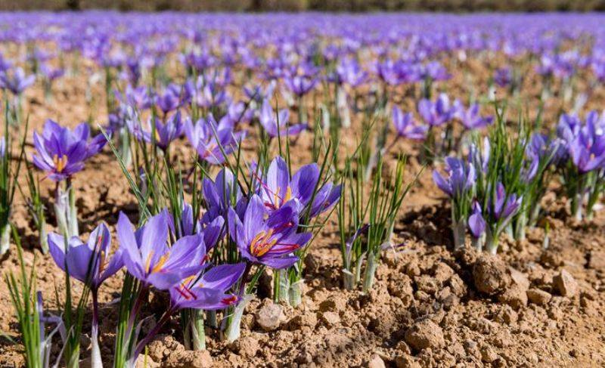
Saffron is the most expensive plant found in the world. Being so expensive, it is also called red gold. Cultivation of saffron is very easy and simple. Saffron crop does not require much hard work. Also, its harvest period is also 3 - 4 months and it can grow upto 15-20 cm in height. Its prices are also increasing day by day, through which farmers can earn good profit.

Slide 74
Uses of Saffron
In milk and milk desserts, saffron is used as a flavour and coluring component.
It's used as season cheese, mayonnaise, and meat, among other things.
In Mughlai cuisine, they are utilized as a flavoring and seasoning agent.
It is used to treat arthritis, infertility, liver enlargement, and fever in Ayurveda.
It's a common ingredient in perfumes and cosmetics.
Major Saffron Production states in India
Jammu & Kashmir and Himachal Pradesh are the two most important producing states. Kesar in Hindi, Kong in Kashmiri, Jafran in Bengali, Zafran in Punjabi, Keshar in Gujarati, Zafran in Urdu, Asra, Aruna, Asrika, Kunkuma in Sanskrit are some of the native names.
Ideal Conditions for Saffron Cultivation
The most basic condition for commercial saffron production is fertile soil. The second major factor is the climate. It necessitates a long photoperiod and a dry, moist soil.
Climate for Saffron Cultivation
Saffron is grown primarily in sunken and dry places with elevations ranging from 1500 to 2500 metres above sea level. It requires a 12-hour photoperiod, which has several advantages but also slows down the flowering process.

Slide 75
Season for Saffron Farming
Saffron Corms are grown in India between the months of June and July, as well as August and September in some areas.
In October, it begins to flower.
In the summer, it requires intense heat and dryness, while in the winter, it requires extreme cold.
Winters in areas of Karnataka, Himachal Pradesh, and Jammu & Kashmir provide the best conditions for development.
Soil for Saffron Farming
One of the most important aspects of saffron growing is the soil. It thrives on loamy, sandy, and calcareous soils. A gravelly soil is also excellent for saffron farming, however a heavy, clayey soil is not.
Saffron grows best on acidic soil. It thrives well when pH of soil is around 5.5 to 8.5.
Water Requirement
Saffron requires less water than other spices. The soil should be slightly damp but not completely dry. Irrigation is done on a weekly basis and 283 m cubic per acre of water must be delivered during the cultivation period.

Slide 76
Time of planting of saffron crop
Any crop must be planted at a specific time. We don't receive the expected yield since we don't plant seeds at the proper time. As a result, make sure to plant the seeds on the fields at the appointed time.
The greatest months to harvest saffron are July and August, with mid-July being the best.
When applying the saffron croms, make a 6 - 7 centimetre pit for the croms to go into, and leave about 10 cm between th
Indoor saffron farming involves cultivating saffron (Crocus sativus) in controlled environments like greenhouses, grow rooms, or hydroponic systems. Unlike traditional outdoor farming, this method gives you full control over light, temperature, and humidity, ensuring optimal growth and yield.
Indoor Saffron Farming?
Due to the following reasons-
High Returns: Saffron’s market price ranges between ₹2.5 lakh to ₹3 lakh per kilogram due to its labor-intensive cultivation and limited supply.
Controlled Environment: You’re not at the mercy of unpredictable weather conditions.
Year-Round Production: Unlike traditional seasonal farming, you can cultivate and harvest saffron throughout the year.
Eco-Friendly Practices: Indoor farming uses resources like water and soil more efficiently, reducing environmental impact.
Choose the Right Location
Your grow room can be set up in a spare room, basement, or greenhouse. Ensure the space is insulated to maintain consistent environmental conditions.
Procure High-Quality Saffron Corms
Saffron corms (bulbs) are the foundation of your business. Look for disease-free, mature corms from trusted suppliers. A single corm can produce saffron for up to five years with proper care.
Initial Investment: A quintal (100 kg) of saffron corms costs around ₹3-5 lakh.
Yield Potential: From 100 kg of corms, you can harvest approximately 1-2 kg of saffron in the first year.

Slide 77
An Ideal Growing Environment
Light: Saffron requires 12-14 hours of light daily. Use LED grow lights for energy efficiency and adjust light intensity to mimic natural sunlight.
Temperature: Maintain a cool temperature between 10-21°C (50-70°F). This range is ideal for healthy flowering.
Humidity: Keep humidity levels between 40-60%. Invest in dehumidifiers to prevent fungal growth.
Soil & Water: Use a well-draining soil mix of sand, perlite, and peat moss. Maintain soil pH between 6-8. Water sparingly to keep the soil slightly moist but not waterlogged.
Multi-Tier Racks & Trays
Maximize space by using multi-tier racks and trays. This allows you to grow more plants in a smaller area, reducing overhead costs.
Cultivation Process
Planting the Corms: Plant corms in rows, ensuring adequate spacing for airflow. Cover them lightly with soil to allow proper root growth.
Monitoring: Regularly check for pests or diseases. Remove any infected plants immediately to prevent contamination.
Flowering Period: Saffron flowers usually appear 6-8 weeks after planting. Each flower produces three red stigmas, which are the valuable saffron threads.
Harvesting
Harvest the flowers early in the morning when the blooms are fresh. Be gentle while plucking the flowers to avoid damaging the stigmas.
Processing
Separate the red stigmas from the flowers by hand. Dry the stigmas using a food dehydrator or low-temperature oven (30-40°C). Store the dried saffron in airtight containers in a cool, dark place to preserve its aroma and color.

Slide 78
Business Strategy and Financials
Business aspects of Indor Saffron farming-
Startup Costs
Expense | Estimated Cost (₹)
Saffron corms (100 kg) | 3,00,000 – 5,00,000
LED grow lights | 50,000 – 1,00,000
Racks and trays | 30,000 – 50,000
Climate control systems | 1,50,000 – 2,00,000
Miscellaneous (soil, tools) | 20,000 – 30,000
Total | 5,50,000 – 9,00,000
Revenue Potential
Yield (kg) | Price per kg (₹) | Total Revenue (₹)
1.5 | 3,00,000 | 4,50,000
2.0 | 3,00,000 | 6,00,000
With proper care and increased yield in subsequent years, your profits can skyrocket.

Slide 79
Marketing and Sales
Online Presence: Build a website and use social media platforms to showcase your saffron.
Collaborate: Partner with local chefs, gourmet stores, and Ayurveda practitioners.
Export Opportunities: Explore export markets in countries like the UAE, USA, and Europe.
Legal and Regulatory Compliance
Register your business under the required agricultural and food safety regulations.
Label your saffron accurately, mentioning its purity and origin.
Sustainability Practices
Use organic fertilizers to enhance soil quality.
Recycle water to minimize waste.
Avoid chemical pesticides to maintain an eco-friendly approach
Advantages of Indoor Saffron Farming
Consistent Quality: You can ensure uniform color, aroma, and taste.
Scalability: Expand easily by adding more racks or grow rooms.
High Market Demand: Saffron is used in cooking, cosmetics, and medicine, ensuring a broad customer base.
Eco-Friendly: Requires minimal water and avoids harmful chemicals.
Challenges in Indoor Saffron Farming
High Initial Investment: Setting up a grow room involves significant costs.
Labor-Intensive: Harvesting and processing saffron threads require meticulous work.
Disease Management: Proper monitoring is essential to prevent fungal infections.

Slide 80
THANKS

