Slide 1

Geo-Spatial Aspect of Food and Health Security in Human-Animal Conflict Zones
School of Agro and Rural Technology (SART)
Indian Institute of Technology, Guwahati
Guwahati, ASSAM, 781039

Slide 2
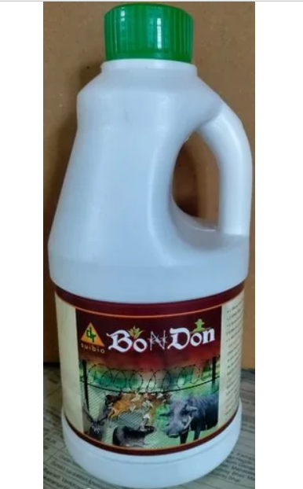
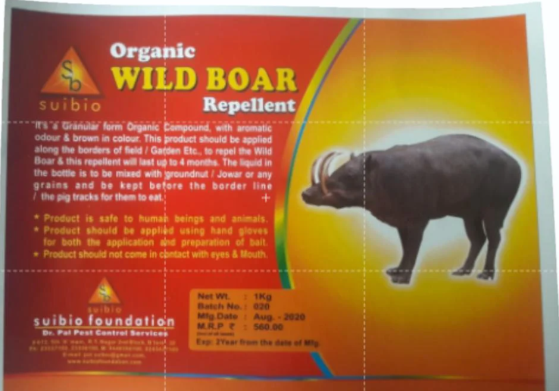
Details About Product Used (Sui BIO Foundation)
Bondon Liquid Emulsion
Approx. Price: Rs 800 / PIECE
Dosage: 20ml in 1Liter Water
Form: Liquid
Frequency of usage: once a month
Working Mechanism: odor aversion, taste aversion, or fear inducement
Liquid Repellent
Wild Boar Organic Repellent
Approx. Price: Rs 560/ PIECE
Dosage: 1kg of Granules cover 20 running feet.
Form: Granules
Frequency of usage: After 4 months of application
Working Mechanism: odor aversion, taste aversion, or fear inducement
Granular Repellent

Slide 3
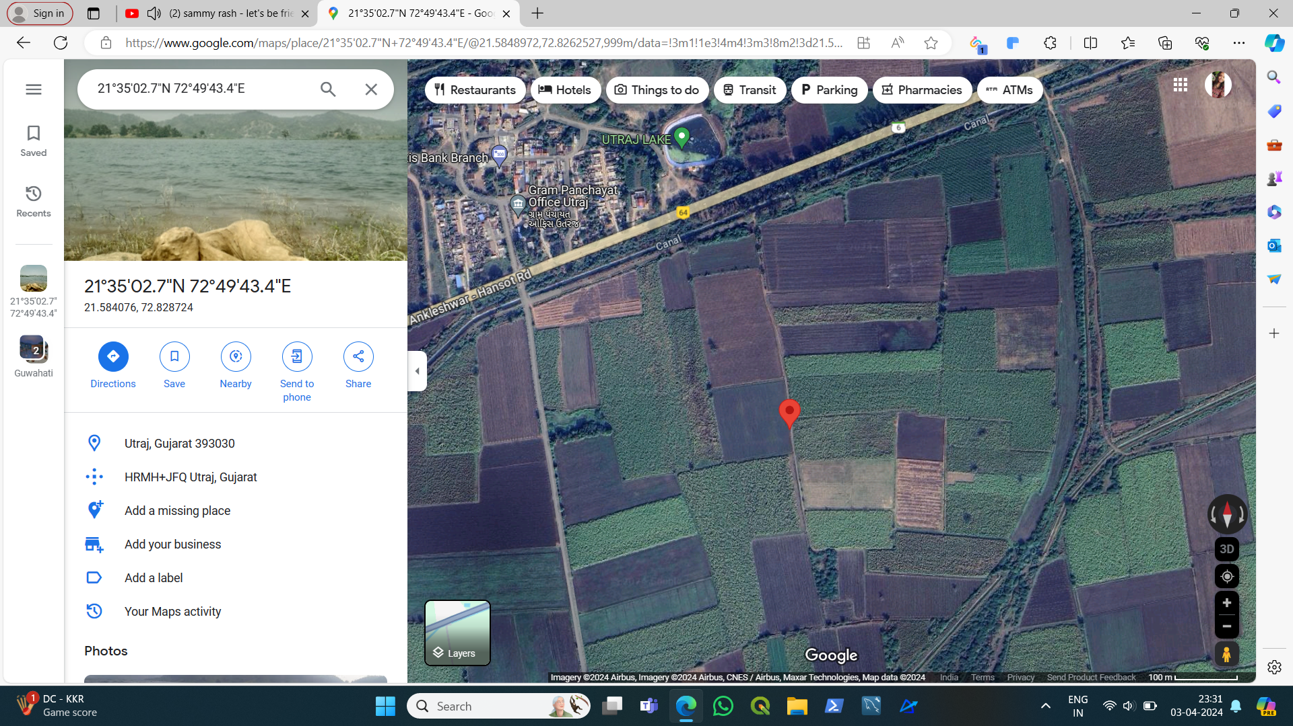
Flowchart of Field Process for wild boar prevention
Non-effective in rainy season.
Observed wild boars in adjacent fields but not in the field under observation.
Site monitoring duration: 15 Days
Majorly effective as compared to other methods like fencing and barricading
Adding Product
Observations
Identify location under observation
Dosage: 5ml in 15 Liter Water
Mode : Spray dispenser
Current location: 21°35'02.7"N 72°49'43.4"E
Utraj, Gujarat 393030
Crop : Sugarcane
Age: 07 months

Slide 4
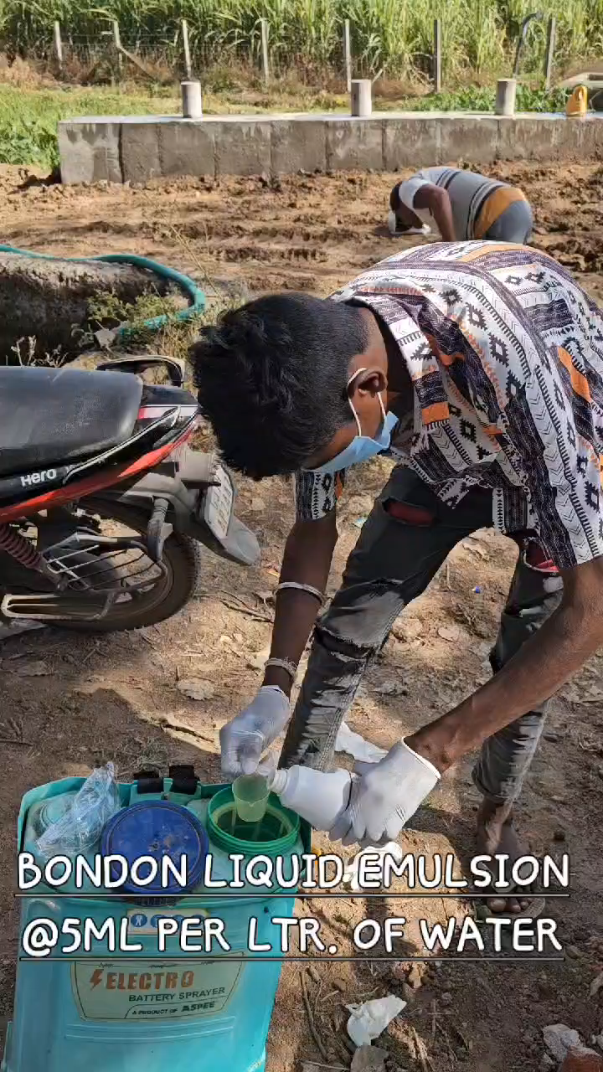
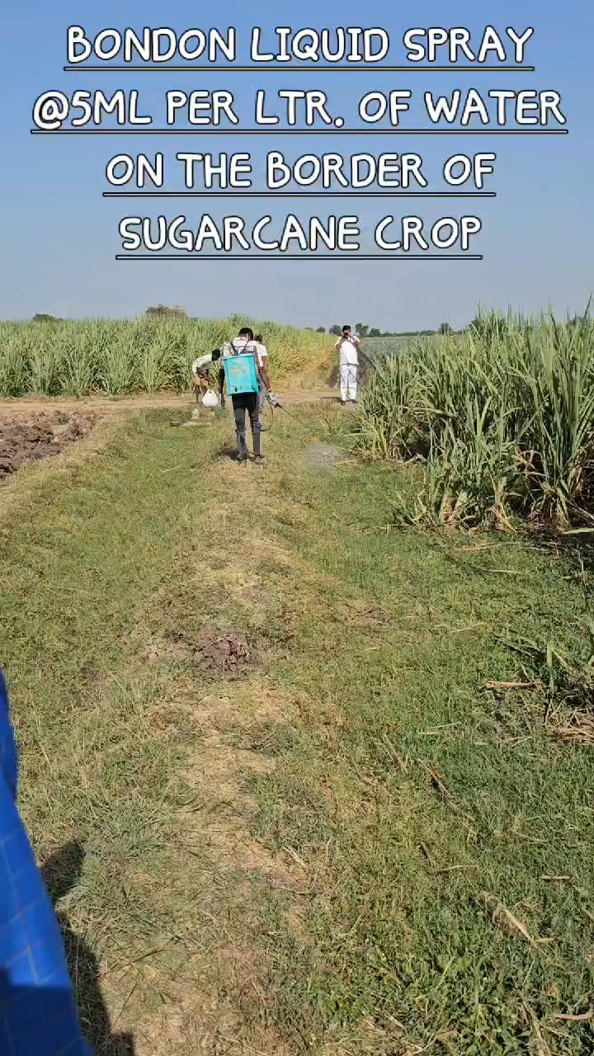
Field Application
(Videos)

Slide 5
Observed Details
Pros of product
Environmentally friendly: Organic repellents typically contain natural ingredients that are safer for the environment compared to chemical alternatives.
Non-toxic: They pose minimal risk to humans, animals, and beneficial insects.
Effective deterrence: Organic repellents can effectively deter wild boars from damaging crops without causing harm to them.
Sustainable: Organic repellents align with sustainable agricultural practices, reducing reliance on harmful chemicals.
Cons of product
Limited efficacy: Organic repellents may not be as potent or long-lasting as chemical alternatives, requiring more frequent application.
Cost: Organic repellents might be more expensive than chemical options, potentially increasing operational costs for farmers.
Variable results: Effectiveness may vary depending on environmental conditions and the behavior of wild boars.
Application challenges: Organic repellents may require specialized equipment or frequent reapplication, adding complexity to farming operations.

Slide 6
Other Product or competitive market for pest control
Wild Boar Repellent, Pig Repeller India, Get Rid of Wild Boar & Pigs (promptpestcontrol.com)
ANIDERS - Animal Intrusion Detection and Repellent System | Kyari for Wildlife
ORGANIC WILD BOAR REPELLENT | BigHaat
Sui BIO Foundation
#612, 5th A main Road, R.T Nagar Bangalore 560033.
Email id: pal.suibio@gmail.com
Ph No: +91 9448356100, +91 9243437100, 080 23336100, 08023537100

